Slide 1
Introduction to Pandas & Jupyter
Lesson 4.1
Notes:
1.1

Slide 2
Class Objectives
By the end of today’s class you will be able to:
Serve Jupyter Notebook files from local directories and connect their development environment.
Create Pandas DataFrames from scratch.
Understand how to run functions on Pandas DataFrame.
Read/write DataFrames from/to CSV files using Pandas.
Notes:
1.1

Slide 3

“We set sail on this new sea because there is new knowledge to be gained...
We choose to go to the Moon! We choose to go to the Moon…
...not because they are easy, but because they are HARD...”
Parts of President John F. Kennedy
Address at the Rice University on the
Nation’s Space Effort delivered on September 12, 1962.
Notes:
Shutterstock_520041586
1.1
A little inspiration slide!
Welcome your students to what may be one of the most challenging weeks in the entire course.

Slide 4


A little something
to assist you throughout your journey..
Notes:
1.1
Slack out the following reference guides and notebooks. These will be useful references for students as they learn Pandas and Jupyter Notebook.
Student Guide
Intro to Pandas
Exploring Pandas

Slide 5
Introduction to Jupyter Notebook
Notes:
1.2

Slide 6

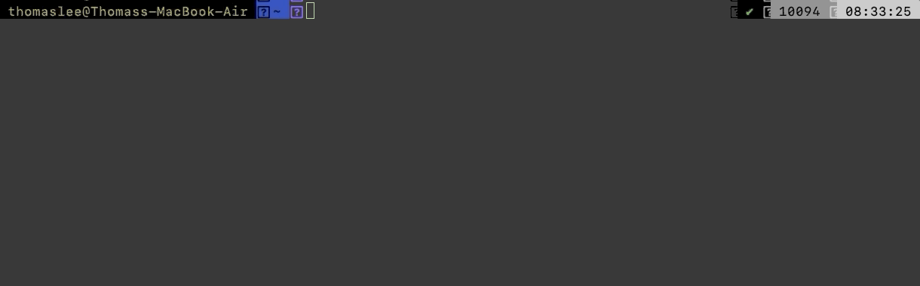
Introduction to Jupyter Notebook
Before diving into Pandas, let’s take few notes on Jupyter Notebook
Jupyter Notebook is an open-source application that allows its users to create documents that contain live code, equations, visualizations, and explanatory text.
In other words, Jupyter Notebook combines a text editor, the console, and a markdown file into one application.
Notes:
1.2
Image sourced at: https://jupyter.org/
Take some time to introduce Jupyter Notebook to the class.
Here it’s some important points to note:
Running jupyter notebook will automatically open up a webpage where users can navigate into any files/folders within the folder they ran the command from.
Users can create new Jupyter Notebook files from the webpage that is opened by clicking the "new" button and selecting their development environment from the list that appears.
Python files created through Jupyter Notebook are given the ipynb extension rather than py and cannot be easily read/altered within a typical text editor.

Slide 7
Introduction to Jupyter Notebook
Before diving into Pandas, let’s take few notes on Jupyter Notebook
Create a Python file with Jupyter Notebook. Set the kernel as ‘PythonData’
Setting the kernel for Jupyter projects is important because these kernels let the program know which libraries will be available for use. Only those libraries loaded into the development environment selected can be used in a Jupyter Notebook project.
If the development environment does not show up within Jupyter Notebook, install the nb_conda_kernels package as directed by the instructor.
Notes:
1.2
Image sourced at: https://jupyter.org/

Slide 8
Introduction to Jupyter Notebook
Before diving into Pandas, let’s take few notes on Jupyter Notebook
Comprehend the structure of the file in Jupyter Notebook and navigating thru it.
Each cell contains Python code which can be run independently by placing the cursor inside a cell and pressing Shift + Enter.
Jupyter notebook allow users to both to experiment with code directly and save it for late.
The running order of the cells won’t dictate the stored value of the code. What dictates in Jupyter Notebook is which cell ran lastly.
Notes:
1.2
Image sourced at: https://jupyter.org/
Explain how each cell contains Python code which can be run independently by placing the cursor inside a cell and pressing Shift + Enter.
Modify some of the code in a cell and point out how Jupyter notebooks allow users to both to experiment with code directly and save it for later
Make sure to run the second to last cell one more time after running the final cell on its own. This shows students how values in Jupyter Notebooks are stored based upon what lines of code were run previously
If needed, use this cheat sheet on the following link: https://s3.amazonaws.com/assets.datacamp.com/blog_assets/Jupyter_Notebook_Cheat_Sheet.pdf for
The following commands are keyboard shortcuts that are not only effective in terms of productivity, but on a personal note makes it really fun to navigate w/o touching the mouse. Note that the shortcuts are for Windows and Linux users. For the Mac users, they’re different buttons for Ctrl, Shift, and Alt:
Ctrl: command key ⌘
Shift: Shift ⇧
Alt: option ⌥
Let them know that they are 2 modes in the Jupyter Notebook App: command mode and edit mode. As a starter here it’s shortcuts shared between the two modes.
Shortcuts in both modes:
Shift + Enter run the current cell, select below
Ctrl + Enter run selected cells
Alt + Enter run the current cell, insert below
Ctrl + S save and checkpoint
While in command mode (press Esc to activate):
Enter take you into edit mode
H show all shortcuts
Up select cell above
Down select cell below
Shift + Up extend selected cells above
Shift + Down extend selected cells below
A insert cell above
B insert cell below
X cut selected cells
C copy selected cells
V paste cells below
Shift + V paste cells above
D, D (press the key twice) delete selected cells
Z undo cell deletion
S Save and Checkpoint
Y change the cell type to Code
M change the cell type to Markdown
P open the command palette. This dialog helps you run any command by name. It’s really useful if you don’t know some shortcut or when you don’t have a shortcut for the wanted command.

Slide 9
Activity: Netflix Remix
In this activity, you will create a Jupyter Notebook that performs the same functions as the Netflix activity from last week.
15 Minutes
Notes:
1.3

Slide 10

Activity: Netflix Remix
Instructions:
Using Netflix.py as a jumping off point, convert the application so that it runs properly within a Jupyter Notebook.
Make sure to have the application print out the user's input, the path to Netflix_Ratings.csv, and the final rating/review for the film in different cells.
Bonus:
Go through any of the activities from last week and attempt to convert them to run within a Jupyter Notebook. While doing this, try to split up the code into cells and print out the outputs.
Hints:
If your development environment does not appear as a potential kernel within Jupyter Notebook, close out of Jupyter Notebook and run conda install -c anaconda nb_conda_kernels within the terminal. Upon reloading Jupyter Notebook, all possible kernels should now appear.
Notes:
1.3

Slide 11
Notes:
1.4
Check lesson plan to review! Or see below:
Open 02-NetflixRemix and walk through the code with the class, answering whatever questions students have.
Key points to cover when discussing this activity:
The code within a cell can be run by placing the cursor inside of it and hitting Shift + Enter
If the code within a cell is not run, then the changes made within will not be saved into memory
The code contained within a Jupyter Notebook is not linear. For example, if two cells modify the same variable, then whichever block of code was run last will ultimately determine the value of the variable

Slide 12
Introduction to Pandas
Notes:
2.1

Slide 13
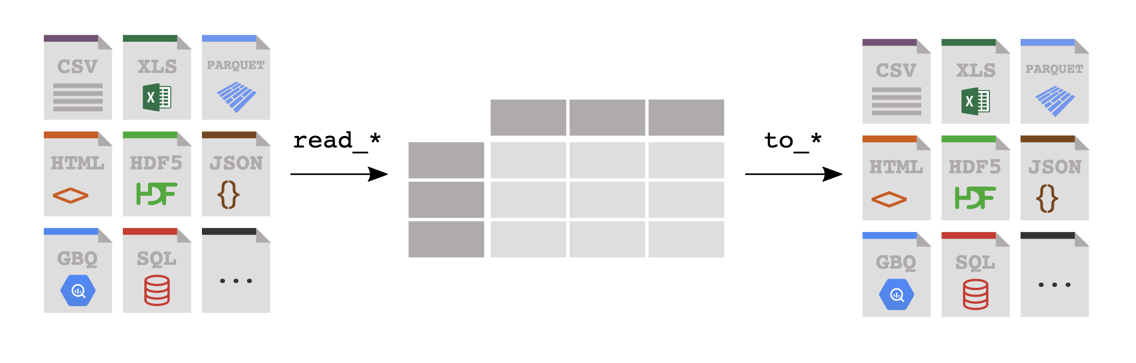
Introduction to Pandas
Thankfully there exists a library that, despite its cute and cuddly name, is extraordinarily powerful when it comes to visualizing, analyzing, and altering large datasets. This library is Pandas.
Pandas
Notes:
2.1
Image sourced at: https://pandas.pydata.org/docs/index.html
The way Jupyter Notebook allows for the testing and visualization of code really starts to shine through when these principles are applied to large tables. As the class has likely realized, however, it can be rather stressful modifying huge datasets using pure Python.
Thankfully there exists a library that, despite its cute and cuddly name, is extraordinarily powerful when it comes to visualizing, analyzing, and altering large datasets. This library is Pandas.

Slide 14
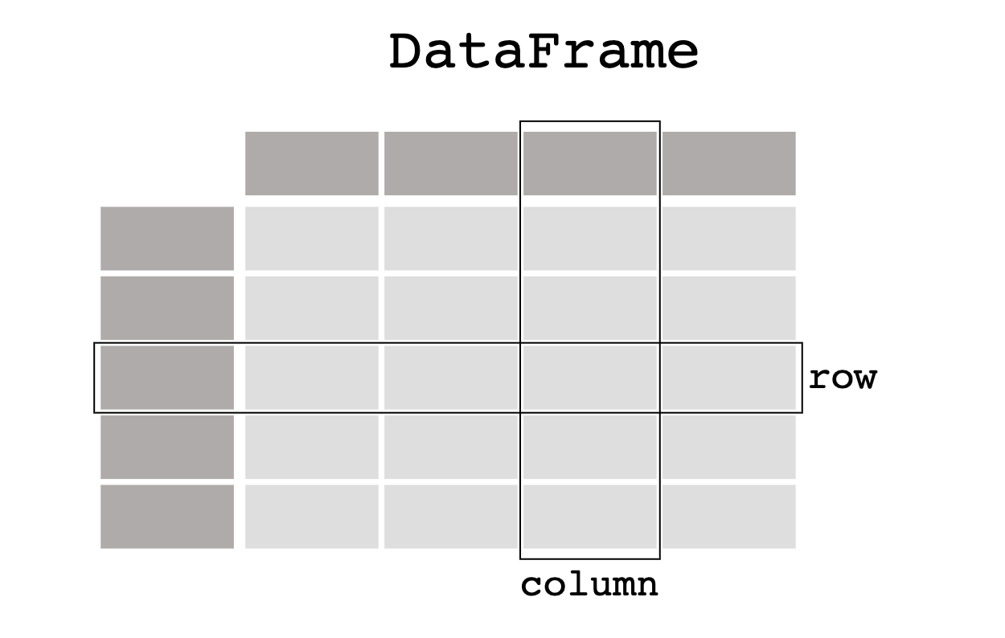

Introduction to Pandas
While Python alone is stuck using lists, tuples, and dictionaries, Pandas lets Python programmers work with "Series" and "DataFrames"
Each Column in a DataFrame is a Series.
Notes:
2.1
Image sourced at: https://pandas.pydata.org/docs/index.html
While Python alone is stuck using lists, tuples, and dictionaries, Pandas lets Python programmers work with "Series" and "DataFrames"
These two data types - unique to Pandas - are essentially structured lists, with many built-in convenience methods that allow for quick and easy manipulation of data
A Pandas Series is a one-dimensional labeled array capable of holding any data type. This means that, like an array, the data is linear but that, like a dictionary, it has an index that acts like a key.
A Pandas DataFrame is a two-dimensional labeled data structure with columns of potentially different types. The easiest way to think of it is like an Excel spreadsheet with each column being a Series.

Slide 15
DataFrame Creation
Notes:
2.2

Slide 16
DataFrame Creation
Few thing to note when creating a DataFrame
First, import Pandas library running import pandas as pd.This method of import allows Pandas functions/methods to be called using the variable pd.
To create a Series, simply run pd.Series() function and place a list within the parentheses. Note that the index for the values within the Series will be the numeric index of the initial list.
Notes:
2.2
Notes can be followed either here, or at LP - as they are similar.
Open 03-IntroToPandas within Jupyter Notebook in order to show the class what Pandas Series and DataFrames are and how to create them.
Before doing anything else, the Pandas library is imported using import pandas as pd. This method of import allows Pandas functions/methods to be called using the variable pd.
To create a Series, simply use the pd.Series() function and place a list within the parentheses. The index for the values within the Series will be the numeric index of the initial list.

Slide 17
DataFrame Creation
Few thing to note when creating a DataFrame
One of many different ways to create DataFrames from scratch is to use the pd.DataFrame() function and provide it with a list of dictionaries. Each dictionary will represent a new row where the keys become column headers and the values will be placed inside the table.
Another way to use pd.DataFrame() function is to provide a dictionary of lists. The keys of the dictionary will be the column headers and the listed values will be placed into their respective rows.
Notes:
2.2
There are multiple ways through which to create DataFrames from scratch. One way is to use the pd.DataFrame() function and provide it with a list of dictionaries. Each dictionary will represent a new row where the keys become column headers and the values will be placed inside the table.
Another way is to use the pd.DataFrame() function like before but this time provide it with a dictionary of lists. The keys of the dictionary will be the column headers and the listed values will be placed into their respective rows.

Slide 18
Activity: Data-Frame Shop
In this activity, you will create DataFrames from scratch using the two methods discussed earlier.
15 Minutes
Notes:
2.3

Slide 19
Activity: DataFrame Shop
Instructions:
Create a DataFrame for a frame shop that contains three columns - "Frame", "Price", and "Sales" - and has five rows of data stored within it.
Using an alternate method from that used before, create a DataFrame for an art gallery that contains three columns - "Painting", "Price", and "Popularity" - and has four rows of data stored within it.
Bonus:
Once both of the DataFrames have been created, discuss with those around you which method you prefer to use and why.
Notes:
2.3
Open up 04-Stu_DataFrameShop within the Jupyter Notebook and to show the end results of the application.

Slide 20
Notes:
2.4
Check lesson plan to review it - or see below:
Open 04-Stu_DataFrameShop and walk through the code with the class, answering whatever questions students have.
Key points to cover when discussing this activity:
It is important to save the DataFrames created to a variable or else they will only be printed to the screen and will not be available for use later on.
While the list of dictionaries method of DataFrame creation is viable, it takes far longer to write the code for since the keys have to be re-written each time. It does allow the programmer to better understand what each row in their DataFrame will look like though.
The dictionary of lists method is much more time effective since the keys need only be written once. It can be harder to read through, however, as if even one of the lists contains fewer values than the others than an error will be returned.

Slide 21
DataFrame Functions
Notes:
3.1 - From here (21) to 28. Move along while lecturing lesson 3.1

Slide 22
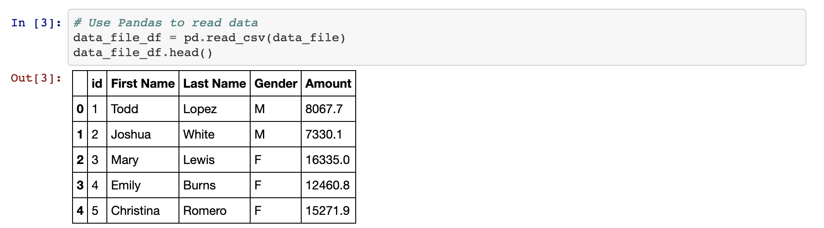
DataFrame Functions
Built in Function: head()
The head() method is helpful in so much as it allows the programmer to look at a minified version of a much larger table, thus allowing them to make informed changes without having to search through the entire dataset.
Notes:
3.1
Open up 05-Ins_DataFunctions within Jupyter Notebook and make sure to point out how an external CSV file is being imported. Students will learn how to do this later in today's lesson.
The first method to describe is that of head() which takes a DataFrame and shows only the first five rows of data inside of it. This number can be increased/decreased, however, by placing an integer within the parentheses.
The head() method is helpful insomuch as it allows the programmer to look at a minified version of a much larger table, thus allowing them to make informed changes without having to search through the entire dataset.

Slide 23
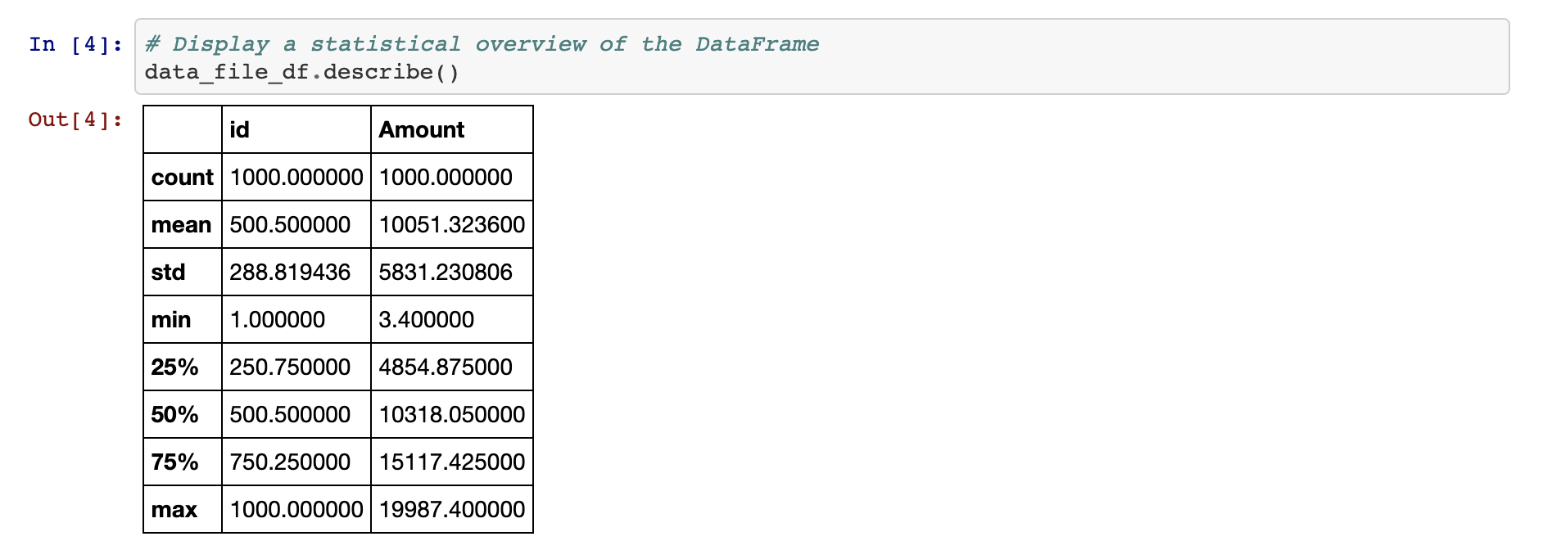
DataFrame Functions
Built in Function: describe()
The describe() method will print out a DataFrame containing some analytic information on the table and its columns. It is also helpful in showing what other data functions can be performed on a DataFrame or Series.
Notes:
3.1
Another useful method comes in the form of describe() which will print out a DataFrame containing some analytic information on the table and its columns. It is also helpful in showing what other data functions can be performed on a DataFrame or Series.

Slide 24
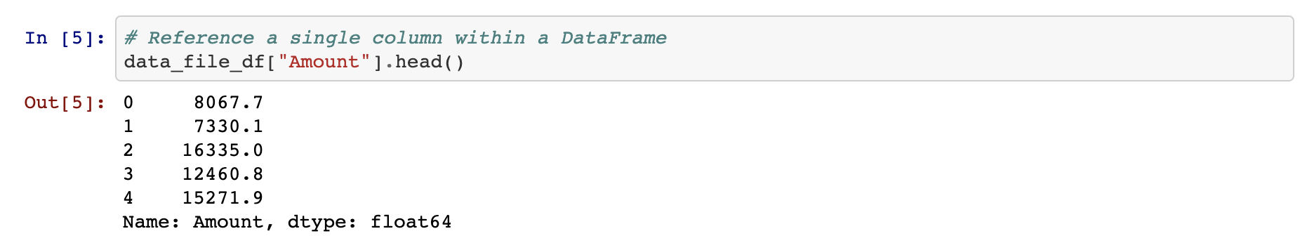
DataFrame Functions
Working with a single column
Most data functions can also be performed on a Series by referencing a single column within the whole DataFrame.
This is done in a similar way to referencing a key within dictionary by taking the DataFrame and following it up with brackets with the desired column's header contained within like a key.
Notes:
3.1
The benefits of using Pandas DataFrames does not lay solely in its visualization of tables. There are also many functions/methods that come packaged with Pandas that allow for quick and easy analysis of large datasets.
Open up 05-Ins_DataFunctions within Jupyter Notebook and make sure to point out how an external CSV file is being imported. Students will learn how to do this later in today's lesson.
The first method to describe is that of head() which takes a DataFrame and shows only the first five rows of data inside of it. This number can be increased/decreased, however, by placing an integer within the parentheses.
The head() method is helpful insomuch as it allows the programmer to look at a minified version of a much larger table, thus allowing them to make informed changes without having to search through the entire dataset.
Another useful method comes in the form of describe() which will print out a DataFrame containing some analytic information on the table and its columns. It is also helpful in showing what other data functions can be performed on a DataFrame or Series.

Slide 25
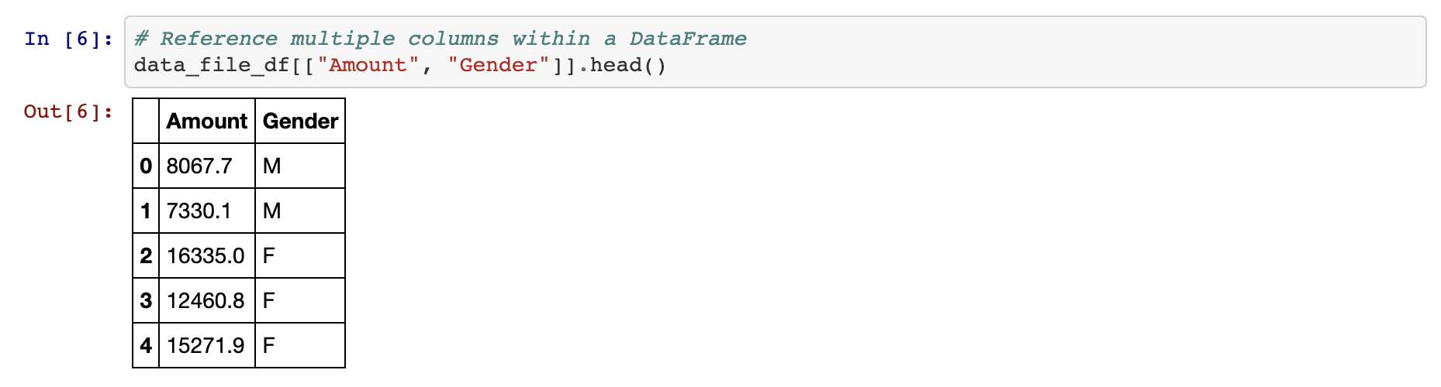
DataFrame Functions
Working with multiple columns
Multiple columns can be referenced as well by placing all of the column headers desired within a pair of double brackets. If two sets of brackets are not used then Pandas will return an error.
Notes:
3.1
Bullet point same as LP

Slide 26
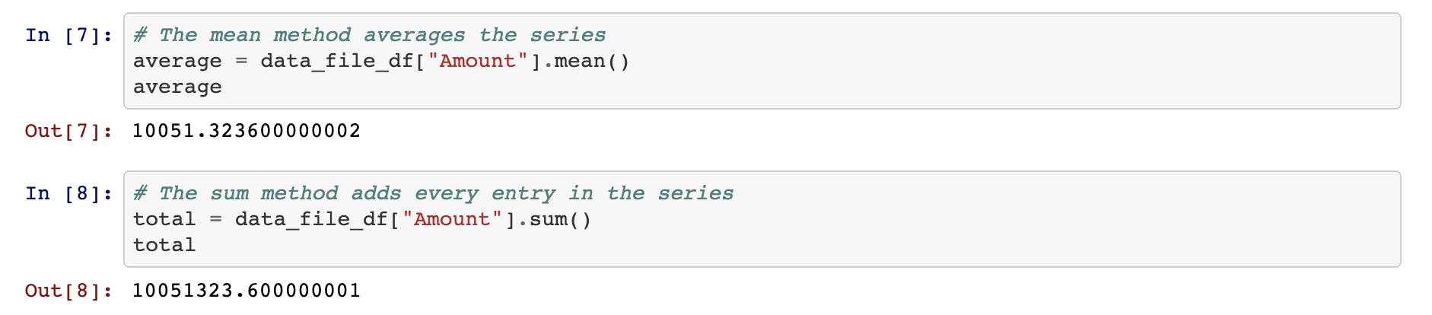
DataFrame Functions
Couple of Aggregating Functions
.mean() method simply computes the mean.
.sum() method add the values.
Notes:
3.1

Slide 27
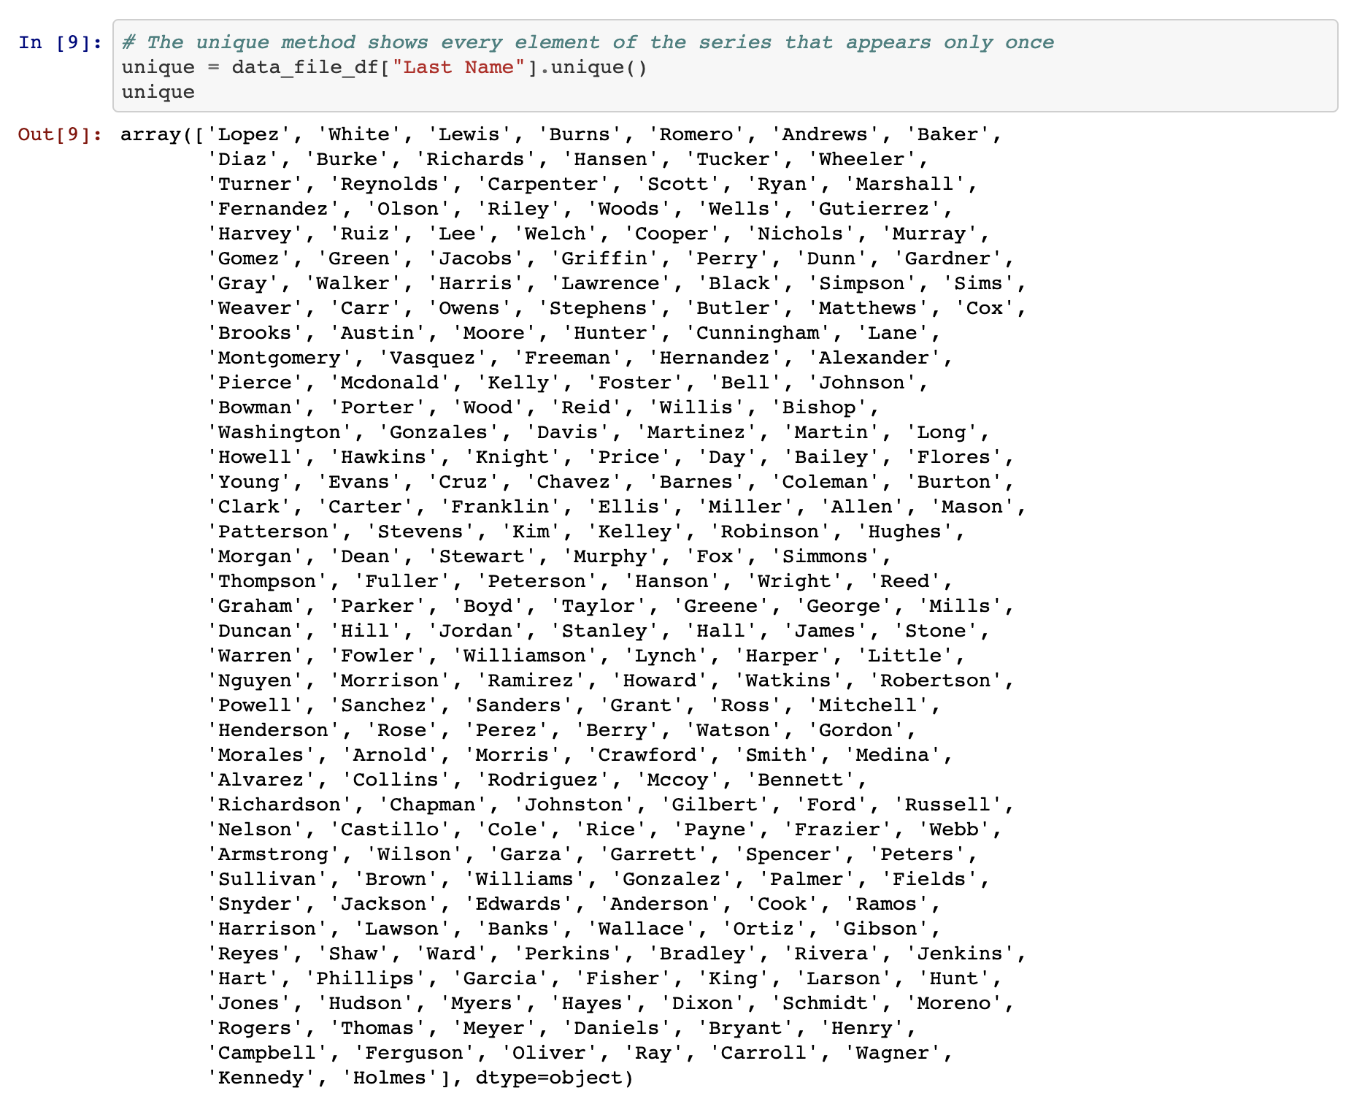
DataFrame Functions
Built in Function: unique()
There are situations in which it is helpful to list out all of the unique values stored within a column. This is precisely what the unique() function does by looking into a Series and returning all of the different values within.
Notes:
3.1
Bullet point same as LP

Slide 28
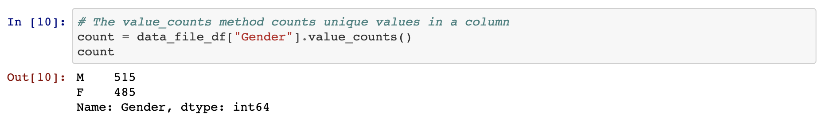
DataFrame Functions
Built in Function: value_counts()
Another method that holds similar functionality is that of value_counts() which not only returns a list of all unique values within a series but also counts how many times a value appears.
Notes:
3.1
Bullet point same as LP

Slide 29
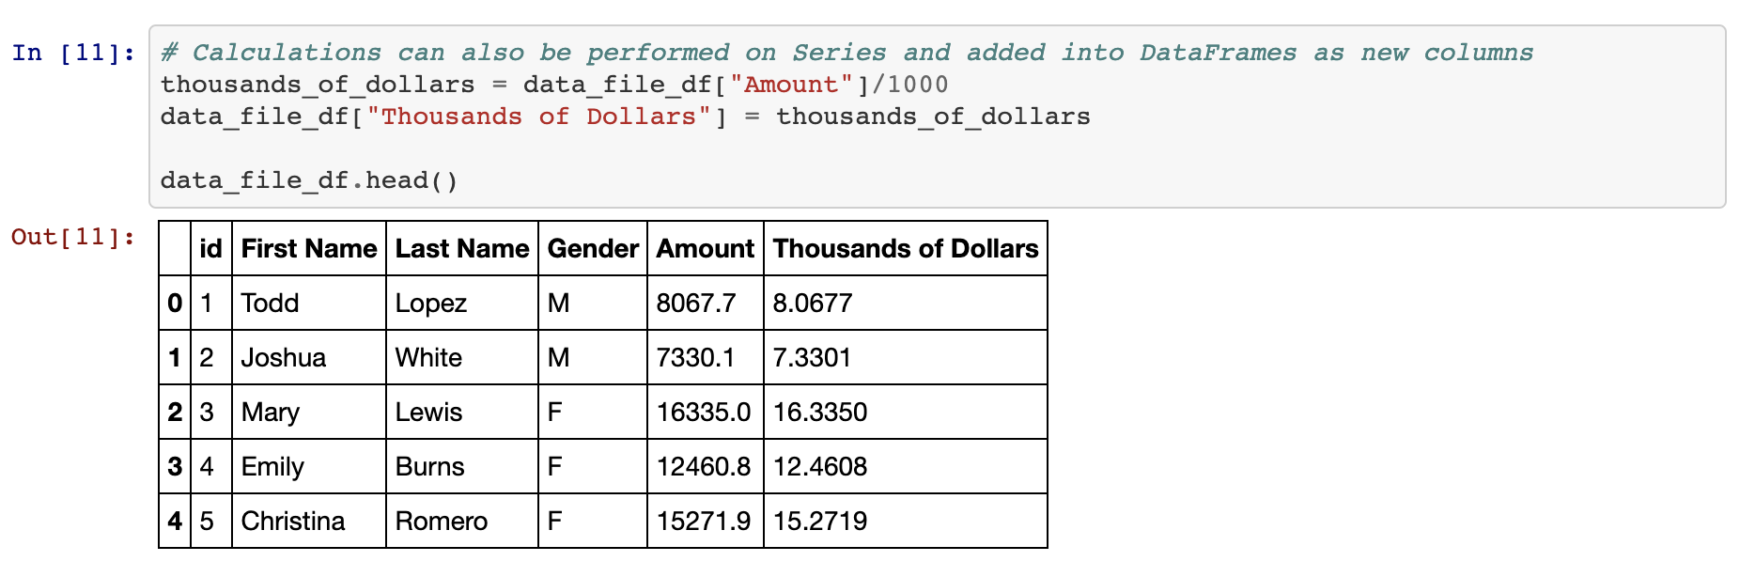
DataFrame Functions
Beyond Pandas Visualization Power...
Calculations can also be performed on columns and then added back into a DataFrame as a new column by referencing the DataFrame, placing the desired column header within brackets, and then setting it equal to a Series.
Notes:
3.1
Bullet point same as LP

Slide 30
Activity: Training Grounds
In this activity, you will now take a large DataFrame consisting of 200 rows, analyze it using some data functions, and then add a new column into it.
15 Minutes
Notes:
3.2

Slide 31
Activity: Training Grounds
Instructions:
Using the DataFrame provided, perform all of the following actions...
Provide a simple, analytical overview of the dataset's numeric columns.
Collect all of the names of the trainers within the dataset.
Figure out how many students each trainer has.
Find the average weight of the students at the gym.
Find the combined weight of all of the students at the gym.
Convert the "Membership (Days)" column into weeks and then add this new series into the DataFrame.
Notes:
3.2
Open up 06-Stu_TrainingGrounds within the Jupyter Notebook and run the code to show the end results of the application.

Slide 32
Notes:
3.3
Check lesson plan to review it - or see below:
Open 06-Stu_TrainingGrounds and walk through the code with the class, answering whatever questions students have.
Key points to tackle when discussing this activity:
By collecting the unique values for the "Trainer" column, it is far easier to see what employees are currently with the "Training Grounds" gym.
In order to convert "Membership (Days)" into "Membership (Weeks)", the code simply takes the values stored within the initial column, divides them by seven, and then adds this edited series into a newly created column.

Slide 33
Modifying Columns
Notes:
4.1

Slide 34
Modifying Columns
Columns Manipulation
There it is a very easy way to modify the names/placement of columns using the rename() function and the use of double brackets.
Use the df.columns method and it will call and an object containing the column headers will be printed to the screen.
Notes:
4.1
As the class already discovered during the previous activity, columns within a DataFrame are not always placed within the desired position by default. In fact, they sometimes may not even have a descriptive or concise enough name.
Thankfully it is very easy to modify the names/placement of columns using the rename() function and the use of double brackets.
Open up 07-Ins_ColumnManipulation within Jupyter Notebook and walk through the code with the class.
In order to collect a list of all the columns contained within a DataFrame, simply use the df.columns call and an object containing the column headers will be printed to the screen.
To reorder the columns, create a reference to the DataFrame followed by two brackets with the column headers placed in the order desired.
It is also possible to remove columns in this way by simply not creating a reference to them. This will, in essence, drop them from the newly made DataFrame.
To rename the columns within a DataFrame, use the df.rename() method and place columns={} within the parentheses. Inside of the dictionary, the keys should be references to the current columns and the values should be the desired column names.

Slide 35
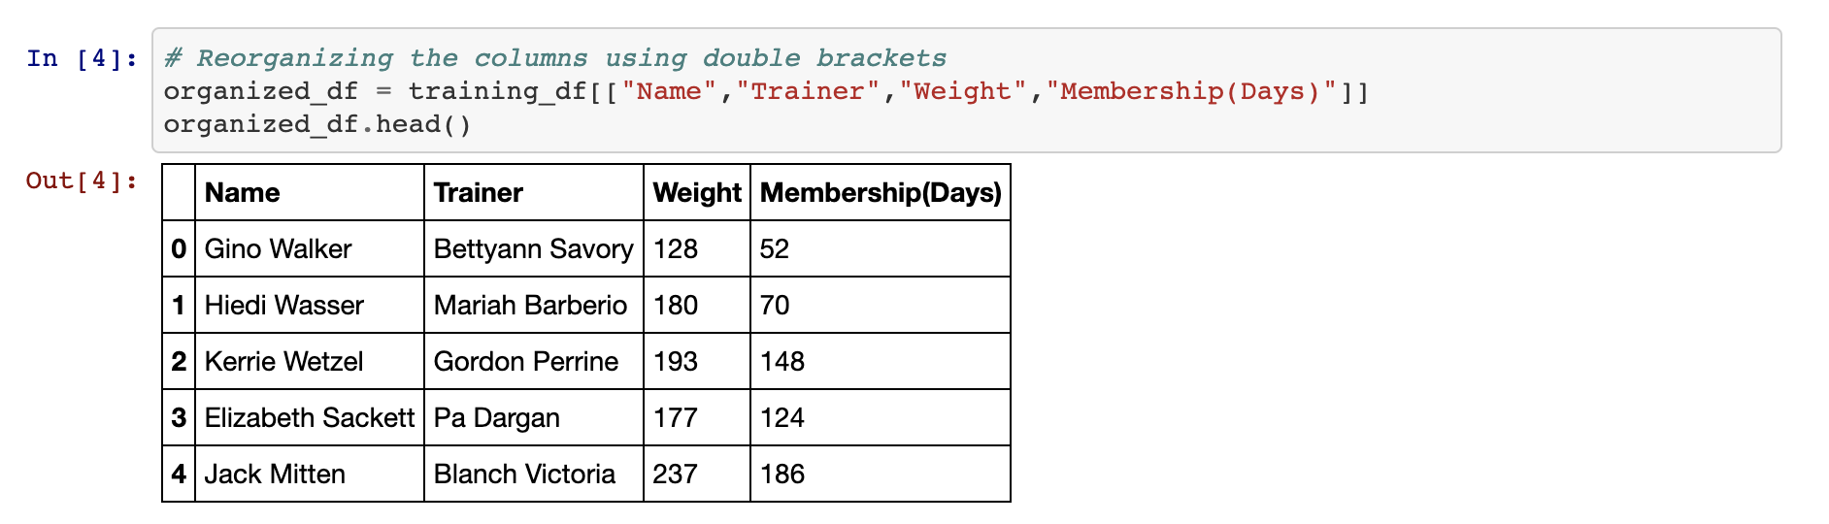
Modifying Columns
Columns Manipulation
To reorder the columns, create a reference to the DataFrame followed by two brackets with the column headers placed in the order desired.
It is also possible to remove columns in this way by simply not creating a reference to them. This will, in essence, drop them from the newly made DataFrame.
Notes:
4.1
As the class already discovered during the previous activity, columns within a DataFrame are not always placed within the desired position by default. In fact, they sometimes may not even have a descriptive or concise enough name.
Thankfully it is very easy to modify the names/placement of columns using the rename() function and the use of double brackets.
Open up 07-Ins_ColumnManipulation within Jupyter Notebook and walk through the code with the class.
In order to collect a list of all the columns contained within a DataFrame, simply use the df.columns call and an object containing the column headers will be printed to the screen.
To reorder the columns, create a reference to the DataFrame followed by two brackets with the column headers placed in the order desired.
It is also possible to remove columns in this way by simply not creating a reference to them. This will, in essence, drop them from the newly made DataFrame.
To rename the columns within a DataFrame, use the df.rename() method and place columns={} within the parentheses. Inside of the dictionary, the keys should be references to the current columns and the values should be the desired column names.

Slide 36
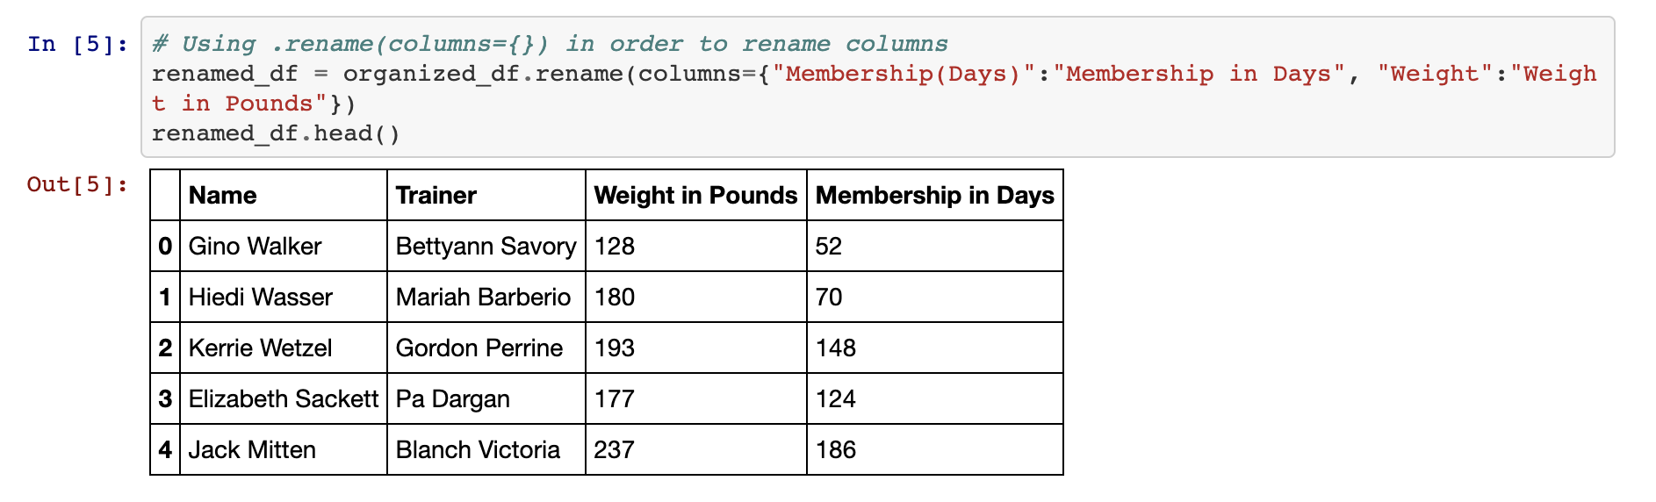
Modifying Columns
Columns Manipulation
To rename the columns within a DataFrame, use the df.rename() method and place columns={} within the parentheses.
Inside of the dictionary, the keys should be references to the current columns and the values should be the desired column names.
Notes:
4.1
As the class already discovered during the previous activity, columns within a DataFrame are not always placed within the desired position by default. In fact, they sometimes may not even have a descriptive or concise enough name.
Thankfully it is very easy to modify the names/placement of columns using the rename() function and the use of double brackets.
Open up 07-Ins_ColumnManipulation within Jupyter Notebook and walk through the code with the class.
In order to collect a list of all the columns contained within a DataFrame, simply use the df.columns call and an object containing the column headers will be printed to the screen.
To reorder the columns, create a reference to the DataFrame followed by two brackets with the column headers placed in the order desired.
It is also possible to remove columns in this way by simply not creating a reference to them. This will, in essence, drop them from the newly made DataFrame.
To rename the columns within a DataFrame, use the df.rename() method and place columns={} within the parentheses. Inside of the dictionary, the keys should be references to the current columns and the values should be the desired column names.

Slide 37
Activity: Hey Arnold!
In this activity, you will be taking a pre-made DataFrame of “Hey Arnold!” characters and reorganizing it so that it is more understandable and organized.
10 Minutes
Notes:
4.2

Slide 38
Activity: Hey Arnold!
Instructions:
First, use Pandas to create a DataFrame with the following columns and values:
Characters_in_show : Arnold, Gerald, Helga, Phoebe, Harold, Eugene.
color_of_hair : blonde, black, blonde, black, unknown, red.
Height : average, tallish, tallish, short, tall, short.
Football_Shaped_Head : True, False, False, False, False, False.
You'll note that the above column names are inconsistent and difficult to work with. Rename them to the following, respectively:
Character, Hair Color, Height, Football Head
Next, create a new table that contains all of the columns in the following order...
Character, Football Head, Hair Color, Height
Notes:
4.2
Open up 08-Stu_Hey_Arnold within the Jupyter Notebook and run the code to show the end results of the application.
If needed it - The code is printed on LP.

Slide 39
Notes:
4.3
Check lesson plan or see below to review it:
Open 08-Stu_Hey_Arnold and walk through the code with the class, answering whatever questions students have.
Key points to tackle when discussing this activity:
The first step is to take the currently named columns and convert them into the more readable versions using hey_arnold.rename(columns={}) and applying the changes to a new variable.
Then, using double brackets, the new columns are reorganized and placed into another new variable which now holds the fully formatted DataFrame.

Slide 40


Notes:
-------------------
Image source: AdobeStock_56885471

Slide 41
Reading and Writing CSV Files
Notes:
5.1

Slide 42
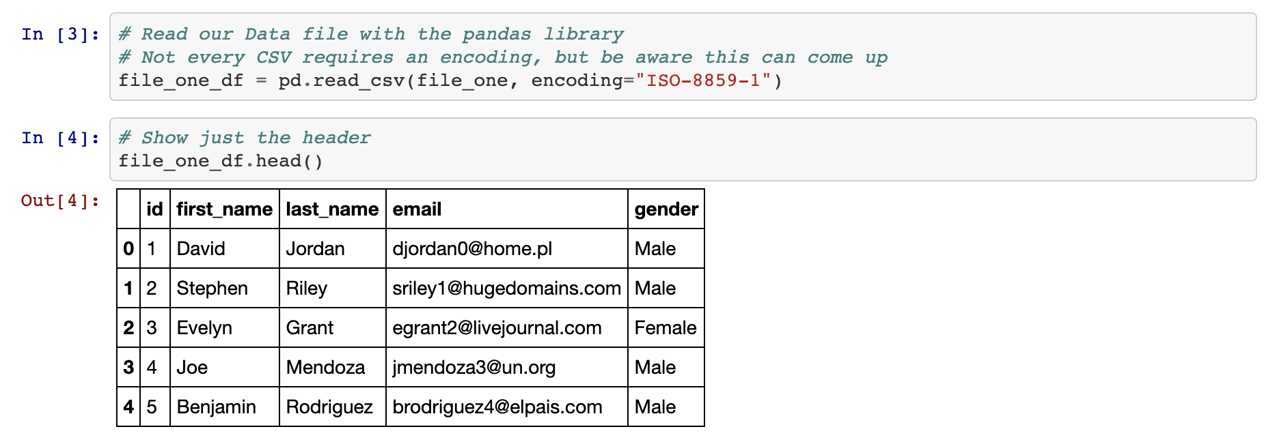
Reading and Writing CSV Files
A Far More Effective Way...
A CSV file's path can be created and passed into the pd.read_csv() method, making certain to store the returned DataFrame within a variable.
Notes:
5.1
Up until this point, the class has had to manually create DataFrames using the pd.DataFrame() method. There is a far more effective means by which to create large DataFrames; importing CSV files.
Open up 09-Ins_ReadingWritingCSV within Jupyter Notebook and walk through the code with the class.
Create a reference to the CSV file's path and pass it in into the pd.read_csv() method, making certain to store the returned DataFrame within a variable. From then on, the DataFrame can be altered and manipulated like normal.
In most cases it is not important to use or define the encoding of the base CSV file but if the encoding is different than UTF-8, then it may become necessary so that the CSV is translated correctly.

Slide 43
Reading and Writing CSV Files
A Far More Effective Way...
It is just as easy to write to a CSV file as it is to read from one. Simply use the df.to_csv() method, passing the path to the desired output file. By using the index and header parameters, programmers can also manipulate whether they would like the index or header for the table to be passed as well.
Notes:
5.1 MAYBE REWORD?
Up until this point, the class has had to manually create DataFrames using the pd.DataFrame() method. There is a far more effective means by which to create large DataFrames; importing CSV files.
Open up 09-Ins_ReadingWritingCSV within Jupyter Notebook and walk through the code with the class.
Create a reference to the CSV file's path and pass it in into the pd.read_csv() method, making certain to store the returned DataFrame within a variable. From then on, the DataFrame can be altered and manipulated like normal.
In most cases it is not important to use or define the encoding of the base CSV file but if the encoding is different than UTF-8, then it may become necessary so that the CSV is translated correctly.
It is just as easy to write to a CSV file as it is to read from one. Simply use the df.to_csv() method, passing the path to the desired output file. By using the index and header parameters, programmers can also manipulate whether they would like the index or header for the table to be passed as well.

Slide 44
Activity: GoodReads Part I
In this activity, you will take a large CSV of books, read it into Jupyter Notebook using Pandas, clean up the columns, and then write their modified DataFrame to a new CSV file.
20 Minutes
Notes:
5.2
Open up the unmodified 10-Stu_GoodReads/Resources/books.csv to show students what they will be working with before opening up 10-Stu_GoodReads/Solved/Output/books.csv to show students what the finished product will look like. The final outputs in the notebook will look like the following:

Slide 45
Activity: GoodReads Part I
Instructions:
Read in the GoodReads CSV using Pandas.
Remove unnecessary columns from the DataFrame so that only the following columns remain: isbn, original_publication_year, original_title, authors, ratings_1, ratings_2, ratings_3, ratings_4, and ratings_5
Rename the columns to the following: ISBN, Publication Year, Original Title, Authors, One Star Reviews, Two Star Reviews, Three Star Reviews, Four Star Reviews, and Five Star Reviews
Write the DataFrame into a new CSV file.
Hints:
The base CSV file uses UTF-8 encoding. Trying to read in the file using some other kind of encoding could lead to strange characters appearing within the dataset.
Notes:
5.2
Open up the unmodified 10-Stu_GoodReads/Resources/books.csv to show students what they will be working with before opening up 10-Stu_GoodReads/Solved/Output/books.csv to show students what the finished product will look like. See LP for final outputs in the notebook.

Slide 46
Notes:
5.3
Check lesson plan or see below to review it:
Open 10-Stu_GoodReads and walk through the code with the class, answering whatever questions students have.
Key points to tackle when discussing this activity:
The initial CSV file is encoded using UTF-8 and should be read using this encoding as well so that ensure there are no strange characters hidden within the dataset.
There are a lot of columns that are being modified within this code, so it is essential to make sure that all references are made accurately so as to avoid any potential errors.
The path to the output CSV must point to an already existing CSV or else an error will be returned. The encoding for the output CSV should also be set as UTF-8 so that those strange symbols from earlier do not appear.

Slide 47
Activity: GoodReads - Part ll
In this activity, you will take the modify version of the GoodReads DataFrame and create a new summary DataFrame based upon that dataset using some of Pandas’ built-in data functions.
20 Minutes
Notes:
5.4

Slide 48
Activity: GoodReads Part ll
Instructions:
Using the modified DataFrame that was created earlier, create a summary table for the dataset that includes the following pieces of information...
The count of unique authors within the DataFrame.
The year of the earliest published book in the DataFrame.
The year of the latest published book in the DataFrame.
The total number of reviews within the DataFrame.
Notes:
5.4
Open up 11-Stu_GoodReadsSummary within the Jupyter Notebook and run the code to show the end results of the application.

Slide 49
Notes:
5.5
Check lesson plan or see below to review it:
Open 11-Stu_GoodReadsSummary and walk through the code with the class, answering whatever questions students have.
Key points to hit upon when reviewing this activity:
The count of unique authors can be found by using len(goodreads_df["Authors"].unique()) which looks into the list of Authors, places all of the unique values into a list, and then finds the list's length.
To find the earliest year, use the min() method on the "Publication Year" column.
To find the latest year, use the max() method on the "Publication Year" column.
To find the total number of reviews given, use the sum() function on each of the " Star Reviews" columns and add up all of the values.
In order to add these values into the summary DataFrame, the values must be placed within brackets. Without doing this, Pandas will return an error.

